Slide 1


Pain and modulatory systems
PT7001 / PT4050
Paul Starrs
P.Starrs@londonmet.ac.uk

Slide 2
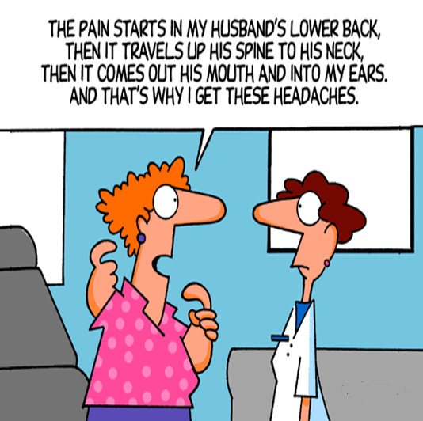
CONTENTS
What is pain?
How do we feel pain?
Where does pain come from?
What types of pain can you feel?
How can it be modulated?

Slide 3
LEARNING OUTCOMES
Explain how pain can arise, how the information is processed in the peripheral and central nervous system, and the physiological basis of treatments designed to reduce pain
Explain the general organisation of pain pathways from skin to brain
Explain the peripheral transducer structure, response characteristics, receptive field, and axon properties of sensory neurons underlying pain sensation
Appreciate the neurochemical and electrophysiological heterogeneity of pain-responsive sensory neurons
Describe the somatotopy of nociceptive input to the spinal cord
Explain the synaptic arrangement and connections of nociceptors within the spinal cord
Understand the basics of pain transmission to the brain and its modification by spinal mechanisms (gate control theory) and descending influences

Slide 4

WHAT IS PAIN?
At first glance, pain seems relatively simple – hitting one’s thumb with a hammer hurts one’s thumb
A structural-pathology model supposes the pain experienced provides an accurate indication of the state of the tissues
However, on closer inspection, pain is less straightforward…

Slide 5

WHAT IS PAIN?
“An unpleasant sensory and emotional experience associated with actual or potential tissue damage”
Notes:
The next few slides are going to go over some examples of why this is the definition, and why the structural-pathology model is not always accurate

Slide 6

PHANTOM LIMB PAIN
Notes:
Not as straight forward as a structural-pathology model!

Slide 7

PAIN IS COMPLICATED!

Slide 8
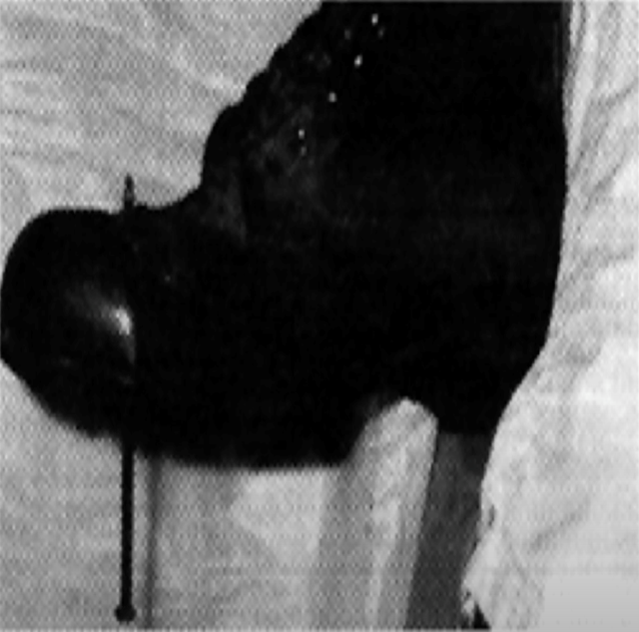
DO PAIN AND TISSUE DAMAGE CORRELATE?
Fisher et al., 1995
Notes:
A builder aged 29 went to the accident and emergency department having jumped down on to a 15 cm nail.
As the smallest movement of the nail was painful he was sedated.
The nail was then pulled out from below.
When his boot was removed, despite entering proximal to the steel toecap the nail had penetrated between the toes: the foot was entirely uninjured.
People can "hallucinate" pain based on perception alone. Strongly suggest that pure psychosomatic pain is also possible.

Slide 9
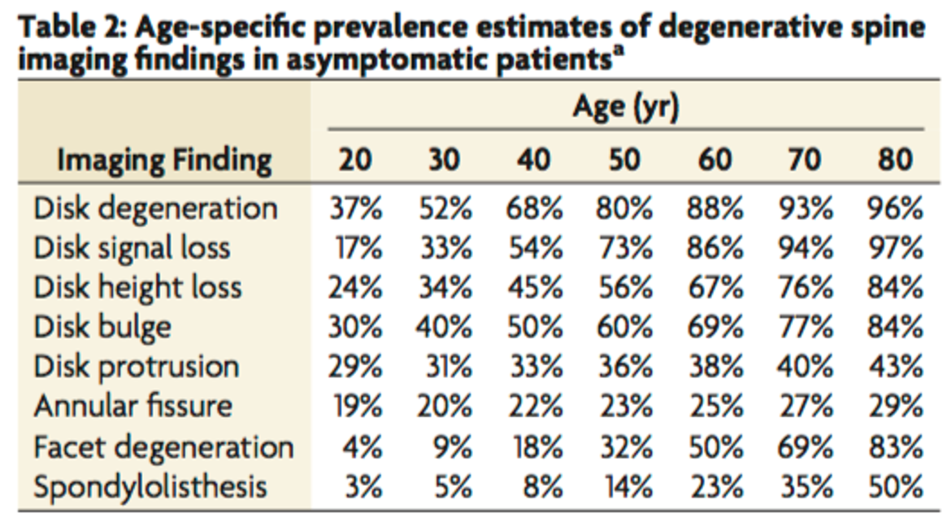
SYMPTOMS AND STRUCTURAL CHANGES
Brinjikji et al. (2015)
Notes:
A study which sought to estimate the prevalence, by age, of common degenerative spine conditions
3110 asymptomatic individuals of varying age
Imaging via MRI or CT to look at structural changes in the spine
Imaging findings of spine degeneration are present in high proportions of asymptomatic individuals, increasing with age. Many imaging-based degenerative features are likely part of normal aging and unassociated with pain.

Slide 10

WHAT IS PAIN?
Nociception – “Sensory nervous system's response to certain harmful or potentially harmful stimuli”
Protective mechanism – USUALLY indicative of a problem
A subjective sensation – Descriptor can give you an idea as to what structure is damaged

Slide 11
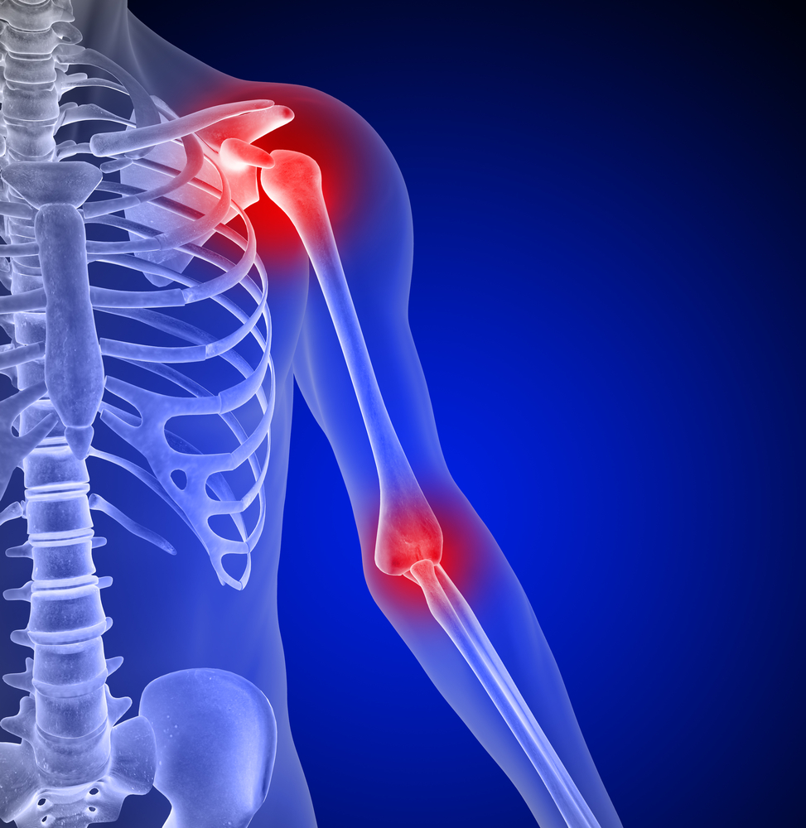
NOCICEPTORS
Free nerve endings which sense pain
Present in:
  Skin, bone, ligament, muscle, tendon, fascia, bursae
Stimulated by:
  Mechanical pressure, chemical release, temperature extremes

Slide 12
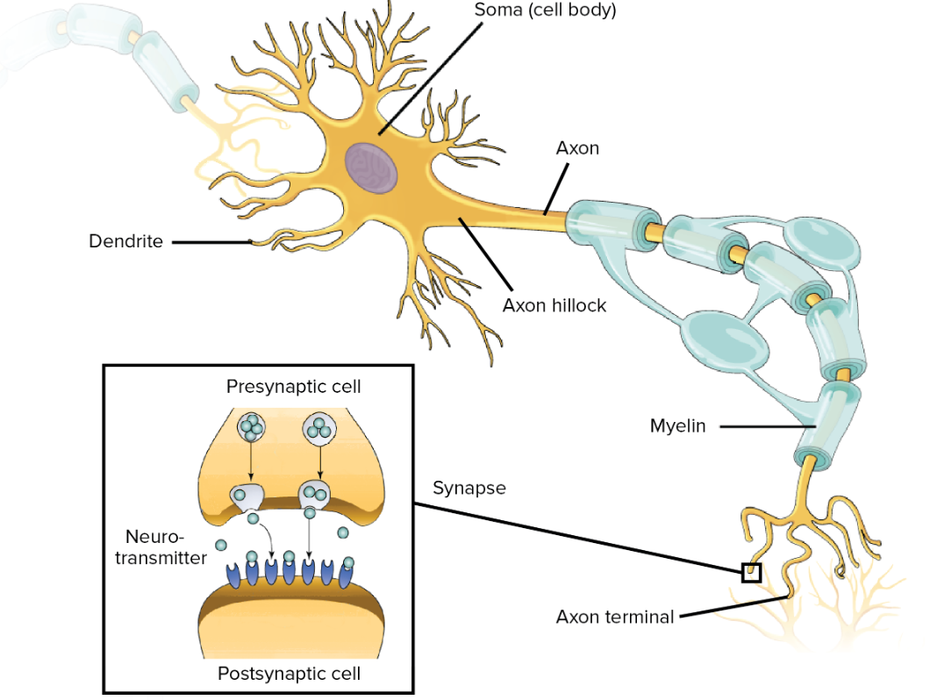
HOW IS PAIN DETECTED?
Noxious stimuli (chemicals, especially from inflammatory processes) are released (Potassium ions, Bradykinin, Serotonin, Prostaglandins, Substance P, etc.)
When electrical energy reaches a threshold value, an action potential is induced and driven towards the central nervous system. This leads to the train of events that allows for the conscious awareness of pain
This threshold value is subject to change i.e. bruise, DOMS or those in chronic pain

Slide 13
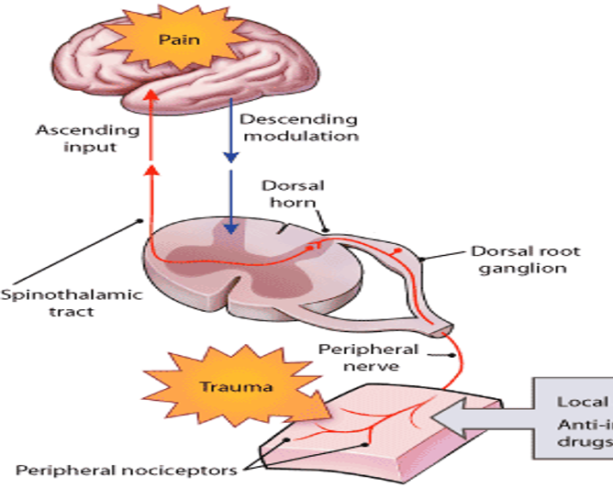
HOW IS PAIN DETECTED?
PERCEPTION
TRANSMISSION
RECEPTION

Slide 14
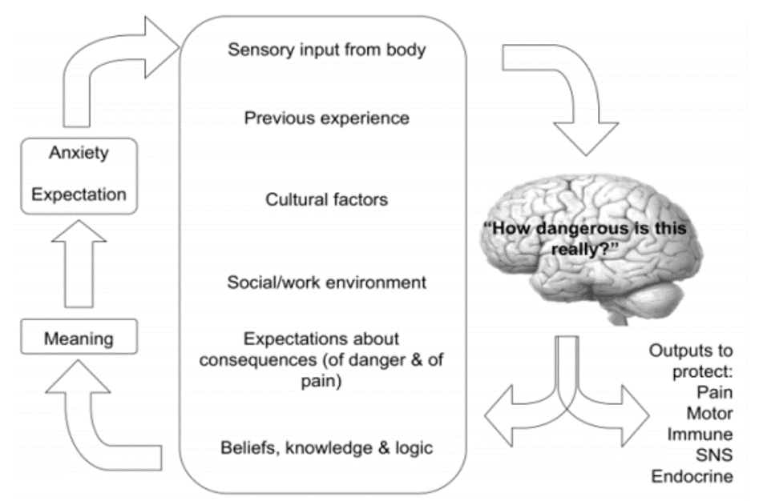
PAIN IS MULTIFACTORAL
Moseley (2007)

Slide 15


HOW IS PAIN DETECTED?
Painful stimuli is detected by sensory neuron
Impulse travels down afferent interneurons and ascent to the brain
Information arrives and is interpreted by brain
Decision about response is made by the brain
Impulses travel down efferent motor neurons and descent to the target tissue
Response is initiated

Slide 16
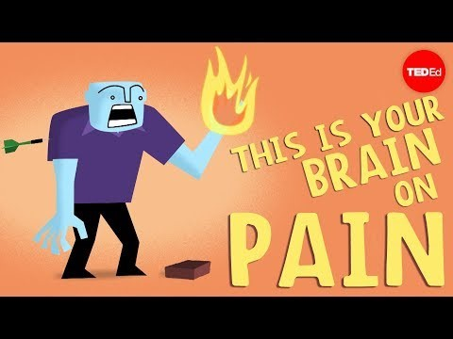
Notes:
https://www.youtube.com/watch?v=I7wfDenj6CQ
People respond differently – Some us a task to distract themselves from the pain OTHERS get distracted by the pain when performing a task
Brain decided what to do with the pain signal to
Acute pain management – Exercise (endorphins), manual therapy (some may respond and others not), medication, meditation
Chronic pain management – CBT

Slide 17


TYPES OF PAIN
ACUTE
< 3 MONTHS
CHRONIC
> 3 MONTHS

Slide 18
ACUTE PAIN
Response to an immediately damaging stimuli
Simulated by chemical release:
  Bradykinin
  Prostaglandins
Transmitted by Aδ (A-DELTA) afferent fibres

Slide 19
CHRONIC PAIN
Responses to presence of continued, potentially pain-provoking, stimuli
Transmitted by C-AFFERENT fibres

Slide 20


NERVE CHARACTERISTICS
Nerve fiber |  | A-delta | C
Appearance
Information carried |  | Sharp pain, temperature | Dull pain, itch
Diameter (micrometers) |  | 1-5 | 0.2-1.5
Speed of signal conduction (metres/second) |  | 5-35 | 0.5-2
Myelinated |  | Yes | No

Slide 21
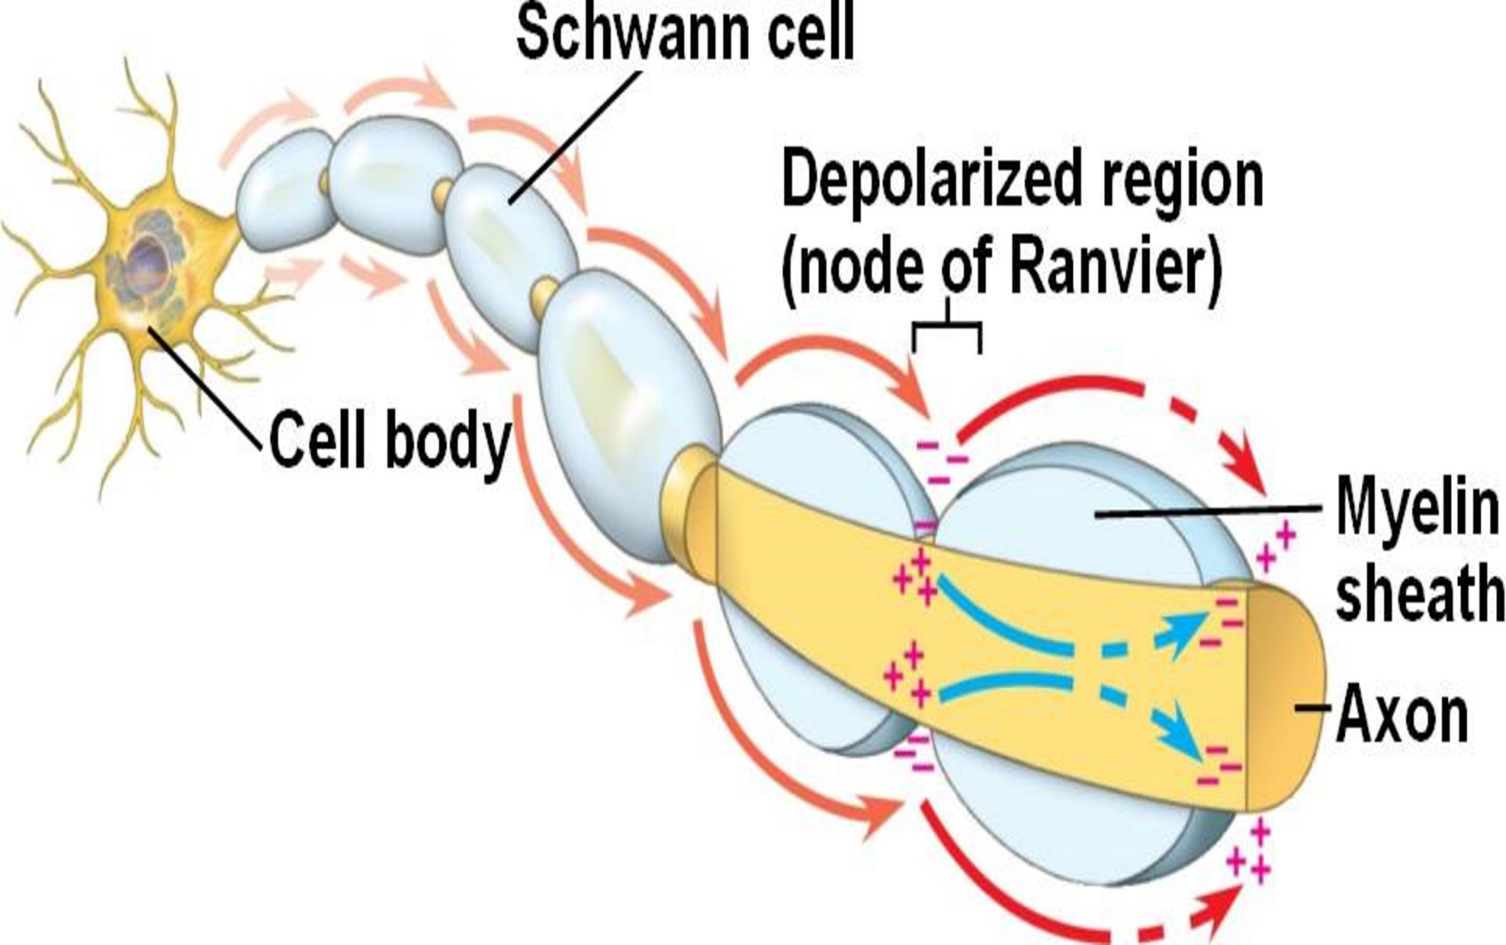
SALTATORY CONDUCTION

Slide 22

NERVE CHARACTERISTICS
Nerve fiber | A-beta | A-delta | C
Appearance
Information carried | Touch | Sharp pain, temperature | Dull pain, itch
Diameter (micrometers) | 6-12 | 1-5 | 0.2-1.5
Speed of signal conduction (metres/second) | 35-75 | 5-35 | 0.5-2
Myelinated | Yes | Yes | No

Slide 23
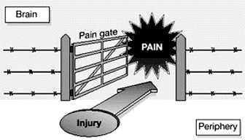
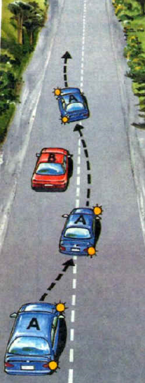
PAIN GATE THEORY
Melzack and Wall (1965)
For sensation of pain to be experienced, pain signals must pass to the brain unopposed
Stimulation of skin mechanoreceptors at same spinal level creates additional sensory signals which stimulate the A-BETA fibres
Pre-synaptic inhibition stops pain signals arriving at the brain and blocks the pain i.e. ‘closes the gate’

Slide 24
ASCENDING INHIBITION
Noxious afferent signals blocked at spinal cord level by touch, heat, ice (sensory afferent impulses)
If occurring at same spinal level i.e. same area then inhibited at Substantia Gelatinosa (a grey matter structure of the dorsal spinal cord) which is the part of spinal cord that receives sensory info and where C fibres usually terminate

Slide 25
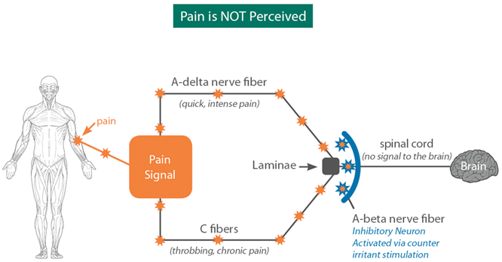
Substantia gelatinosa

Slide 26
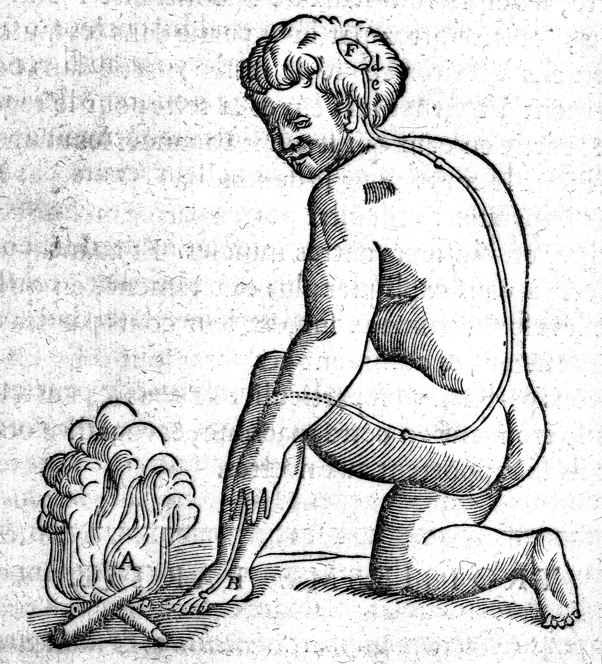
PAIN AS A PERCEPTION
The ‘Pain Gate Theory’, although seminal, is outdated and based on the assumption that we have unimodal, as opposed to multimodal, nerve fibres
Descrates, 1600

Slide 27
DESCENDING INHIBITION
Whilst we need pain to protect us from further damage, we can turn off pain when appropriate, via our internal modulation mechanism i.e. fight or flight
The brain can request the release of specific hormones (noradrenaline) that can have analgesic effects which can reduce or inhibit pain sensation
The area of the brain that stimulates the release of these hormones is the hypothalamus

Slide 28


Slide 29
PAIN IS MULTIFACTORAL
Moseley (2007)

Slide 30

DESCENDING INHIBITION
Brain perceives the pain but decides to modulate it (survival mode)
Signals to hypothalamus and impulse sent down brain stem (medulla oblongata)
Descends down spinal cord
Interrupts signal in spinal cord between synapse of inter-neuron and sensory-neuron (which will usually carry the signal to the brain)
Signal cannot ascend

Slide 31
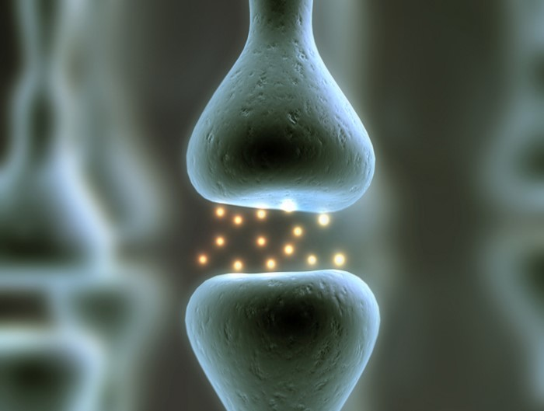
DESCENDING INHIBITION
Noradrenaline secreted into synaptic space by analgesic neuron to inhibit pain signal
Analgesics such as morphine (opiates) work in this way too – stop synaptic transmission
Speculation as to this is also how hands on Rx has an effect on pain perception

Slide 32
CENTRAL PAIN PATHWAYS
Pain is based on experience where many factors including environment, memory, lifestyle, etc can directly affect the sensation
Neuroplasticity changes pathways
Rx and rehab can alter this = Repeated afferent input can evoke plastic (permanent) changes in central nervous system
Placebo and nocebo

Slide 33
CHRONIC PAIN
Not usually associated with structural damage, more an increasingly sensitive nervous system
Features include hyperalgesia and allodynia

Slide 34
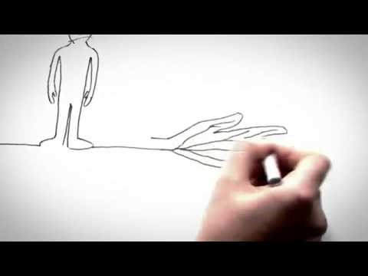
Notes:
https://www.youtube.com/watch?v=C_3phB93rvI

Slide 35
CHRONIC PAIN IDENTIFICATION
Screen / identify them by looking for YELLOW flags:
  Attitude – Fear avoidance behaviour and an expectation that passive, rather than active Rx, will be best
  Beliefs – ‘Something must be seriously wrong’
  Compensation
  Diagnosis – ‘Its bone on bone’, ‘My spine is crumbling’, ‘I have the knee of a 75 year old’, etc.
  Emotions – Look out for signs of low mood
  Family & work – Either overbearing or unsupportive & a poor relationship with a job that they do not enjoy

Slide 36
CHRONIC PAIN MANAGEMENT
Manage them using PINK flags:
  Show empathy
  Use clear communication with careful language and make sure that is understood
  Explain pain
  Do not send for further investigation if you do not believe the results will change the management
  Exercise rehabilitation

Slide 37
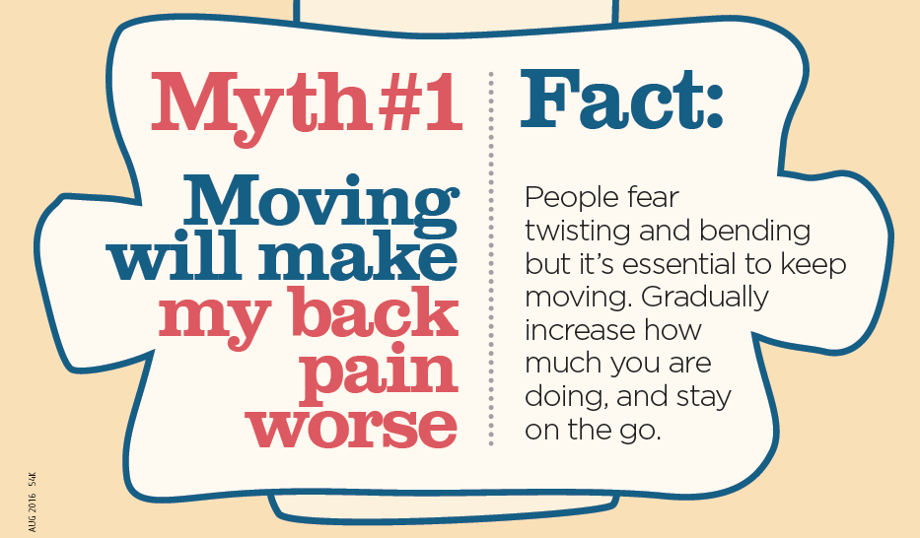
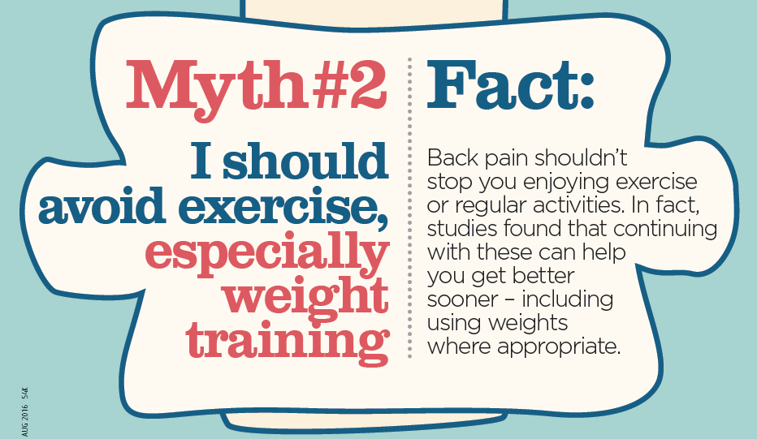
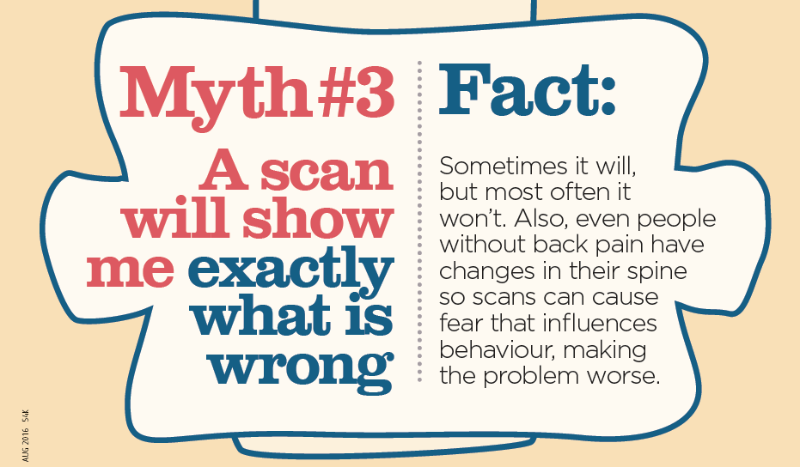
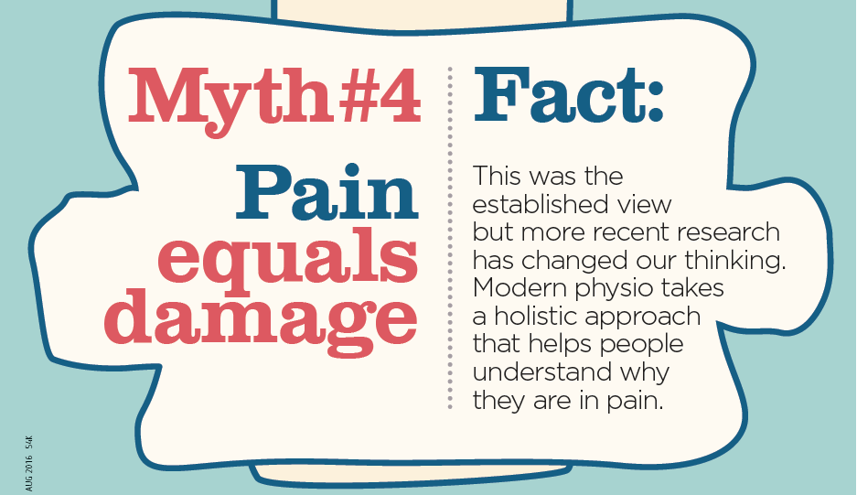

Slide 38
SUMMARY
Pain is complicated!
Perception of pain is very multifactorial, but it is always determined by the brain
Rx and rehab can influence pain positively, the exact mechanisms occur, mainly, due to ascending / descending inhibition and neuro-plasticity changes in the brain

Slide 39

ANY QUESTIONS?

